Slide 1
All-or-Nothing Atomicity
An action is atomic
  if there is no way for a higher layer to discover the internal structure of its implementation
<> From the point of view of a procedure that invokes an atomic action
  The atomic action always appears either to complete as anticipated, or to do nothing
  atomic actions useful in recovering from failures

Slide 2
Before-or-After Atomicity
<> From the point of view of a concurrent thread
  An atomic action acts as though it occurs either completely before or completely after every other concurrent atomic action
  This consequence: makes atomic actions useful for coordinating concurrent threads
Atomicity hides
  not just the details of which steps form the atomic action
  But the very fact that it has structure

Slide 3
All-or-Nothing and Before-or-After Atomicity
1. Data abstraction
  Hide the internal structure of data
2. Client/server organization
  Hide the internal structure of major subsystems
3. Atomicity
  Hide the internal structure of an action
Enforce industrial-strength modularity
  Guarantee absence of unanticipated interactions among components of a complex system
The implementer’s point of view
  Painfully knowing the detail

Slide 4
Atomic actions’ benevolent side effects
audit log
  atomic actions that run into trouble record
    the nature of the detected failure and
    the recovery sequence
  for later analysis
Data management system when insert a record
  rearrange the file into a better physical order
Cache
Garbage collection
They are all hidden from upper levels

Slide 5
Overall system fault tolerance model
error-free operation:
  All work goes according to expectations
  The user initiates actions and the system confirms the actions by displaying messages to the user
tolerated error:
  The user who has initiated an action notices that the system failed before it confirmed completion of the action
  when the system is operating again, checks to see whether or not it actually performed that action

Slide 6
Overall system fault tolerance model
untolerated error:
  The system fails without the user noticing
  the user does not realize that he or she should check or retry an action that the system may not have completed

Slide 7
Disk Storage System Fault Tolerance Model
A perfect-disk assumption
  a disk never decays and that it has no hard errors
  only one thing can go wrong: a system crash at just the wrong time

Slide 8
Disk Storage System Fault Tolerance Model
The fault tolerance model
  error-free operation:
    CAREFUL_GET returns the result of the most recent call to CAREFUL_PUT
    at sector_number on track, with status = OK.
  detectable error:
    The operating system crashes during a CAREFUL_PUT
    and corrupts the disk buffer in volatile storage
    and CAREFUL_PUT writes corrupted data on one sector of the disk.

Slide 9
ALL_OR_NOTHING_PUT
procedure ALMOST_ALL_OR_NOTHING_PUT (data, all_or_nothing_sector)
CAREFUL_PUT(data, all_or_nothing_sector.S1)
CAREFUL_PUT (data, all_or_nothing_sector.S2) //commit point
CAREFUL_PUT (data, all_or_nothing_sector.S3)
procedure ALL_OR_NOTHING_GET (reference date,all_or_nothing_sector)
CAREFUL_GET (data1, all_or_nothing_sector.S1)
CAREFUL_GET (data2, all_or_nothing_sector.S2)
CAREFUL_GET (data3, all_or_nothing_sector.S3)
if (data1 = data2) data ← data1
else data ← data3
Notes:
Why “Almost”?
- Not repair previous damage

Slide 10
ALL_OR_NOTHING_PUT
procedure ALL_OR_NOTHING_PUT (data, all_or_nothing_sector)
CHECK_AND_REPAIR (all_or_nothing_sector)
ALMOST_ALL_OR_NOTHING_PUT (data, all_or_nothing_sector)
procedure CHECK_AND_REPAIR (all_or_nothing_sector) // Ensure copies match
CAREFUL_GET (data1, all_or_nothing_sector.S1)
CAREFUL_GET (data2, all_or_nothing_sector.S2)
CAREFUL_GET (data3, all_or_nothing_sector.S3)

Slide 11
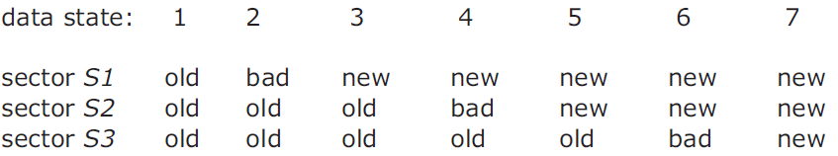
ALL_OR_NOTHING_PUT
if (data1 = data2) and (data2 = data3) return // State 1 or 7, no repair
if (data1 = data2)
CAREFUL_PUT (data1, all_or_nothing_sector.S3) return // State 5 or 6.
if (data2 = data3)
CAREFUL_PUT (data2, all_or_nothing_sector.S1) return // State 2 or 3.
CAREFUL_PUT (data1, all_or_nothing_sector.S2) // State 4, go to state 5
CAREFUL_PUT (data1, all_or_nothing_sector.S3 // State 5, go to state 7

Slide 12
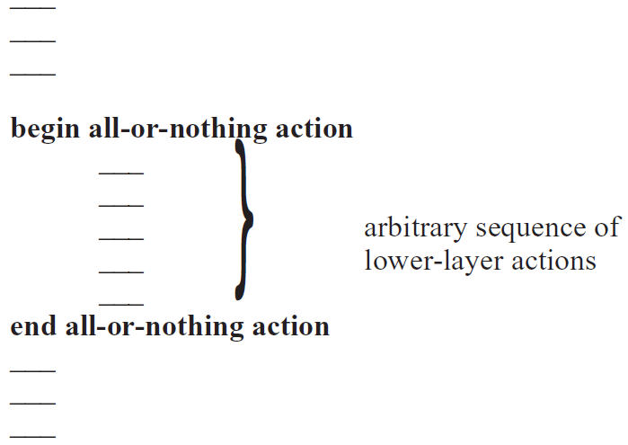
Atomicity

Slide 13
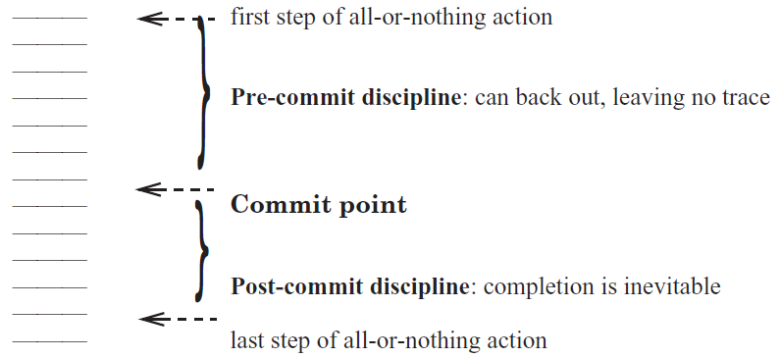
Commit

Slide 14
Commit
Pre-commit
  identify all the resources needed to complete the all-or-nothing action,
  establish their availability
  maintain the ability to abort at any instant
    shared resources, once reserved, cannot be released until the commit point is passed
    should not do anything externally visible
Post-commit
  release reserved resources that are no longer needed
  perform externally visible actions
  CANNOT try to acquire additional resources
Q: where’s commit in ALL_OR_NOTHING_PUT?

Slide 15
Shadow Copy
Pre-commit:
  Create a complete duplicate working copy of the file that is to be modified
  make all changes to the working copy
Commit point:
  Carefully exchange the working copy with the original
  Typically this step is bootstrapped
Post-commit:
  Release the space that was occupied by the original
The golden rule of atomicity
  Never modify the only copy!

Slide 16
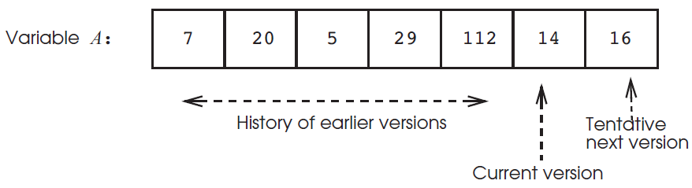
Journal Storage
a store operation
  Not overwrites old data
  create a new, tentative version of the data
    remains invisible to any reader outside this all-or-nothing action
    until the action commits

Slide 17
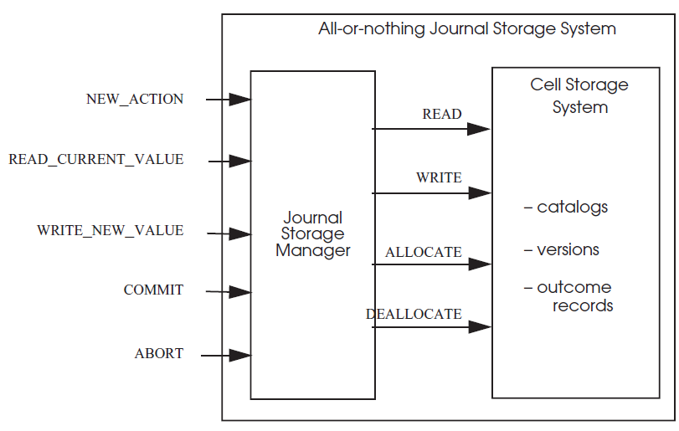
Journal Storage

Slide 18
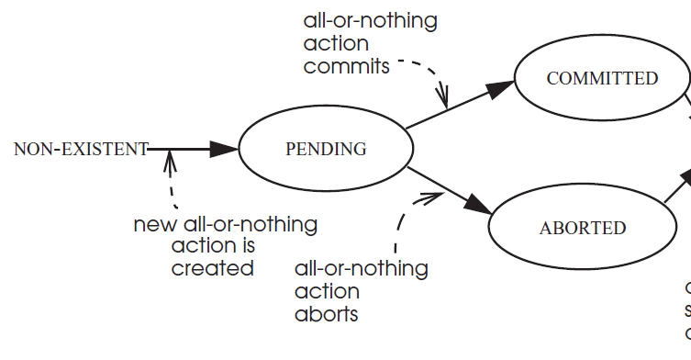
Journal Storage

Slide 19
Journal Storage
procedure NEW_ACTION ()
id ← NEW_OUTCOME_RECORD ()
id.outcome_record.state ← PENDING
return id
procedure COMMIT (reference id)
id.outcome_record.state ← COMMITTED
procedure ABORT (reference id)
id.outcome_record.state ← ABORTED

Slide 20
Journal Storage
procedure READ_CURRENT_VALUE (data_id, caller_id)
starting at end of data_id repeat until beginning
v ← previous version of data_id // Get next older version
a ← v.action_id // Identify the action a that created it
s ← a.outcome_record.state // Check action a’s outcome record
if s = COMMITTED then
return v.value
else skip v // Continue backward search
signal (“Tried to read an uninitialized variable!”)

Slide 21
Journal Storage
procedure WRITE_NEW_VALUE (reference data_id, new_value, caller_id)
if caller_id.outcome_record.state = PENDING
append new version v to data_id
v.value ← new_value
v.action_id ← caller_id
else signal (“Tried to write outside of an all-or-nothing action!”)

Slide 22
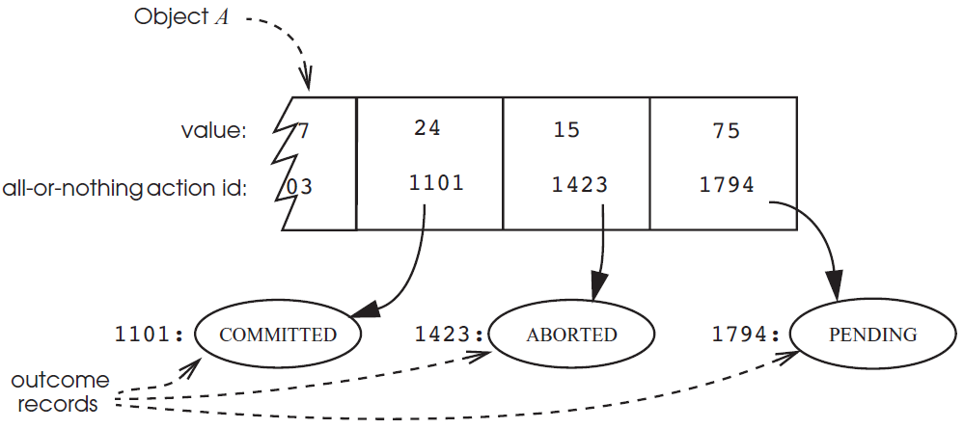
Journal Storage

Slide 23
Journal Storage
procedure TRANSFER (reference debit_account, reference credit_account, amount)
my_id ← NEW_ACTION ()
xvalue ← READ_CURRENT_VALUE (debit_account, my_id)
xvalue ← xvalue - amount
WRITE_NEW_VALUE (debit_account, xvalue, my_id)
yvalue ← READ_CURRENT_VALUE (credit_account, my_id)
yvalue ← yvalue + amount
WRITE_NEW_VALUE (credit_account, yvalue, my_id)
if xvalue > 0 then
COMMIT (my_id)
else
ABORT (my_id)
signal (“Negative transfers are not allowed.”)

Slide 24
Log
The application
  first logs the change in journal storage
  then it installs the change in cell storage
separates the reading and writing of data from the failure recovery mechanism
Minimize the number of storage accesses required for the most common activities
  Reads, updates
Rarely-performed activities may not be minimal
  failure recovery

Slide 25
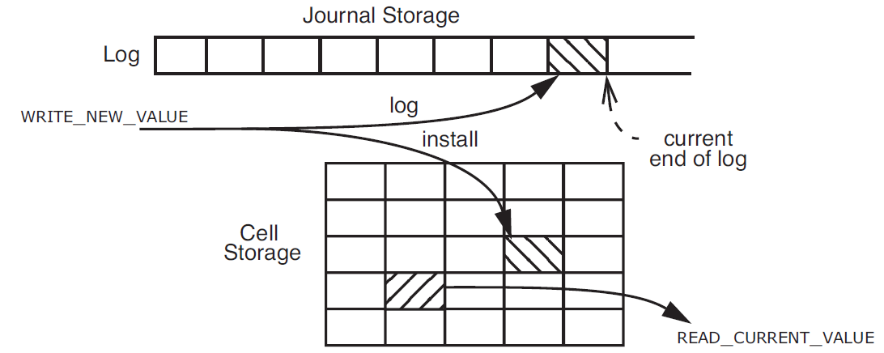
Log
Write-ahead-log protocol (WAL)
  Log the update before installing it

Slide 26
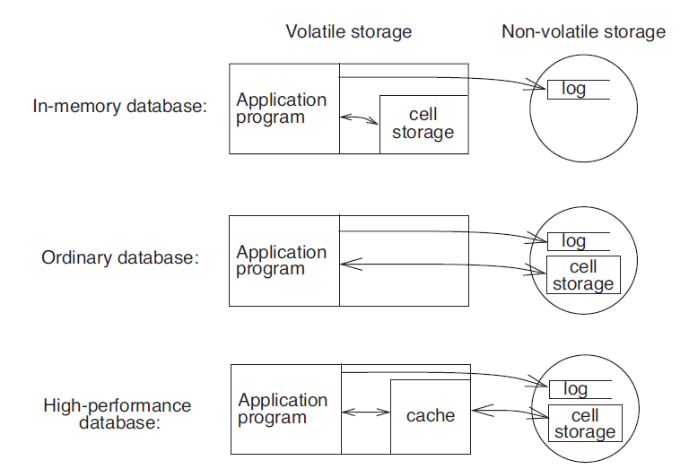
Log

Slide 27
Logging Protocol
CHANGE Record
  The identity of the all-or-nothing action
  （1）A component action redo
    installs the intended value in cell storage
      After commit, if the system crashes , the recovery procedure can perform the install on behalf of the action
  （2）A second component action undo
    reverses the effect on cell storage of the install
      After aborts or the system crashes, it may be necessary for the recovery procedure to reverse the effect

Slide 28
Logging Protocol
The application
NEW_ACTION
  log a BEGIN record that contains just the new identity
  As the all-or-nothing action proceeds through its pre-commit phase, it logs CHANGE records
To implement COMMIT or ABORT
  logs an OUTCOME record
  commit point

Slide 29
Logging Protocol
procedure TRANSFER (debit_account, credit_account, amount)
my_id ← LOG (BEGIN_TRANSACTION)
dbvalue.old ← GET (debit_account)
dbvalue.new ← dbvalue.old - amount
crvalue.old ← GET (credit_account, my_id)
crvalue.new ← crvalue.old + amount
LOG (CHANGE, my_id,
“PUT (debit_account, dbvalue.new)”, //redo action
“PUT (debit_account, dbvalue.old)” ) //undo action

Slide 30
Logging Protocol ---transfer (cont.)
LOG ( CHANGE, my_id,
“PUT (credit_account, crvalue.new)” //redo action
“PUT (credit_account, crvalue.old)” ) //undo action
PUT (debit_account, dbvalue.new) // install
PUT (credit_account, crvalue.new) // install
if dbvalue.new > 0 then
LOG ( OUTCOME, COMMIT, my_id)
else
LOG (OUTCOME, ABORT, my_id)
signal(“Action not allowed. Would make debit account negative.”)
LOG (END_TRANSACTION, my_id)

Slide 31
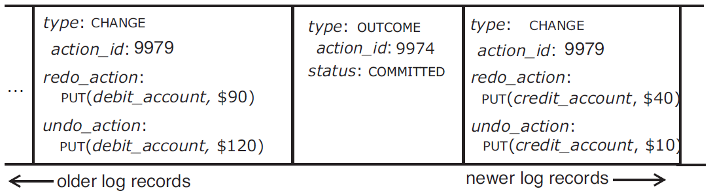
Logging Protocol

Slide 32
Logging Protocol
procedure ABORT (action_id)
starting at end of log repeat until beginning
log_record ← previous record of log
if log_record.id = action_id then
if (log_record.type = OUTCOME)
then signal (“Can’t abort an already completed action.”)
if (log_record.type = CHANGE)
then perform undo_action of log_record
if (log_record.type = BEGIN)
then break repeat
LOG (action_id, OUTCOME, ABORTED) // Block future undos.
LOG (action_id, END)

Slide 33
Logging Protocol: in-memory database
procedure RECOVER () // Recovery procedure for a volatile, in-memory database.
winners ← NULL
starting at end of log repeat until beginning
log_record ← previous record of log
if (log_record.type = OUTCOME)
then winners ← winners + log_record // Set addition.
starting at beginning of log repeat until end
log_record ← next record of log
if (log_record.type= CHANGE)
and (outcome_record ← find (log_record.action_id) in winners)
and (outcome_record.status = COMMITTED) then
perform log_record.redo_action

Slide 34
Soft state
  Can be discarded, no need to redo
Crash during recovery (volitile cell )

Slide 35
Non-volatile logging
NEW_ACTION 111
CHANGE 111
  New A→ old A
CHANGE 111
  New B -> old B
  ( some install )
OUTCOME 111
  COMMIT
  ( some install )
END 111

Slide 36
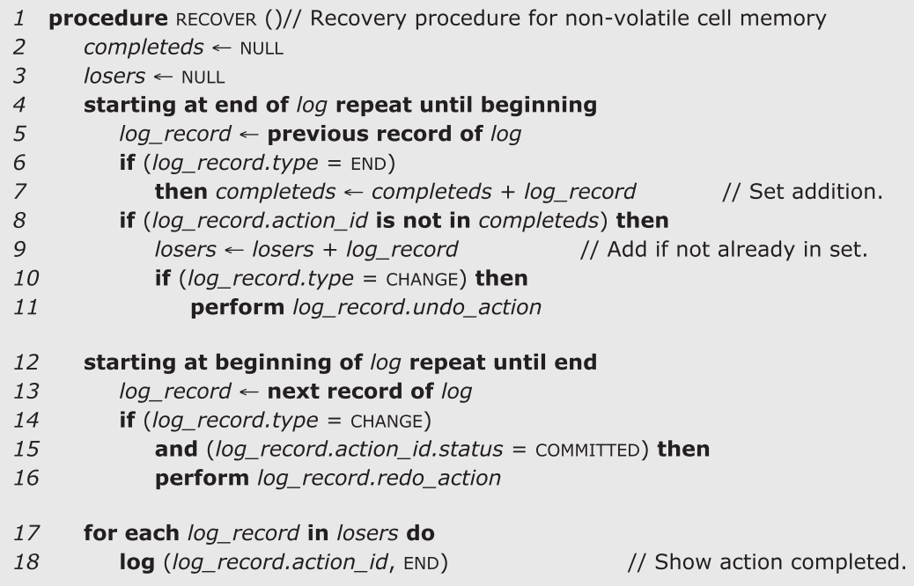


Logging Protocol: non-volatile cell memory
Necessary ?

Slide 37
Undo logging
NEW_ACTION 114
CHANGE 114
  New A→ old A
  New B -> old B
  ( install the cell )
OUTCOME 114
  COMMIT
END 114

Slide 38
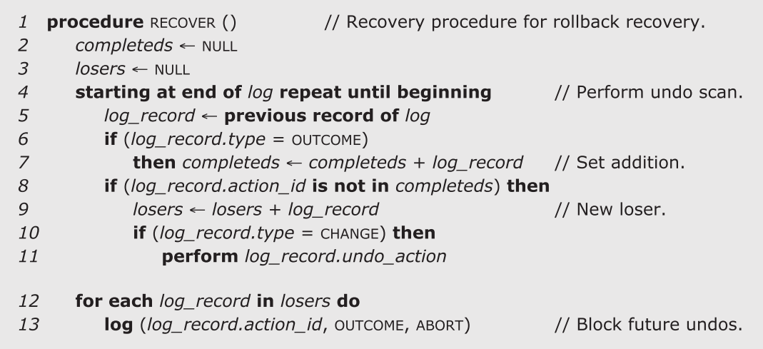
Undo logging Logging Protocol: non-volatile cell memory

Slide 39
redo logging
NEW_ACTION 114
CHANGE 114
  New A→ old A
  New B -> old B
OUTCOME 114
  COMMIT
  ( install the cell )
END 114

Slide 40
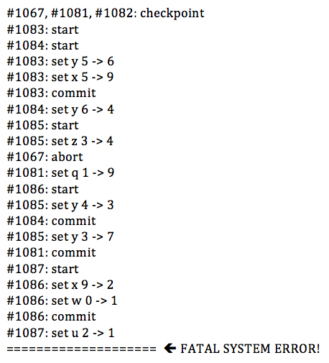

Slide 41
winners: 1067, 1081, 1084, 1083, and 1086
losers: 1082, 1085, and 1087

